Slide 1
Programming for Psychologists
Lecture 3 September 16 2019
Extra information: http://osdoc.cogsci.nl

Slide 2
Today we swap to OpenSesame
Software to build and run experiments
User friendly interface
Python
Use devices (like eye-tracker, EEG equipment)
Free (most other software is expensive)
Crossplatform (Windows, Linus, Mac OS)
http://osdoc.cogsci.nl/3.1/
(we use the version 3.1.7)
Demonstration (to start OpenSesame: press windows-key and type opensesame, press enter and it will start)

Slide 3
The “stroop test”
Reported by John Ridley Stroop (1935)
Name colors:
Name colors of word:
GREEN YELLOW BLUE ORANGE PURPLE RED
Right pane is the hardest, because the word’s identity interferes with its color! This interference was explained by the automation of reading, where the mind automatically determines the semantic meaning of the word (it reads the word "red" and thinks of the color "red"), and then must intentionally check itself and identify instead the color of the word (the ink is a color other than red), a process that is not automatized.

Slide 4
Creating a Stroop test in OpenSesame
In Tuesday´s assignment you will create several variants of this stroop test
Today in class, we’ll create a basic version together (and see why inline scripts are useful)
You can build further on this basic version in the excercises
GREEN
RED

Slide 5
The design
Consecutively show different words in a varying color (1 word at a time)
Participants have to respond as fast as possible to the color of the word (not the identity of the word)
R-key if red, G if green and B if blue
3 conditions (divided in separate blocks):
Congruent (word color and identity are same; e.g. GREEN)
Incongruent (word color and identity are different; e.g. BLUE)
Neutral (word color and identity have nothing (or little!) to do with each other; e.g. FORK)
Notes:
Ging erg goed. Was wel ruim een kwartier te kort

Slide 6
The design
3 separate blocks
Congruent
RED, GREEN, BLUE
Incongruent
RED, GREEN, BLUE
Neutral
FORK, SPOON, TABLE, KNIFE, TOWEL
Each block contains 20 trials
Each trial separated by a 300 ms fixation display

Slide 7
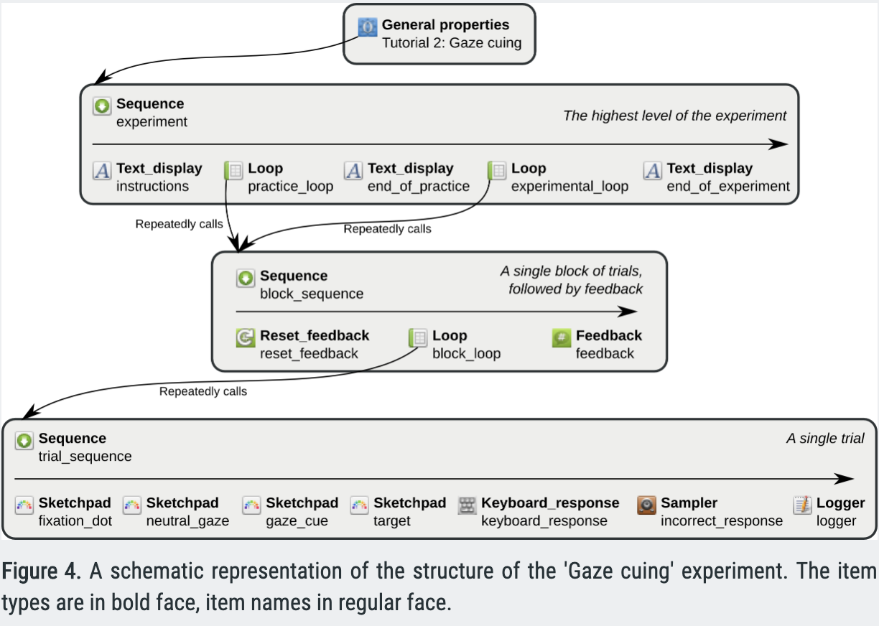
Experimental design

Slide 8
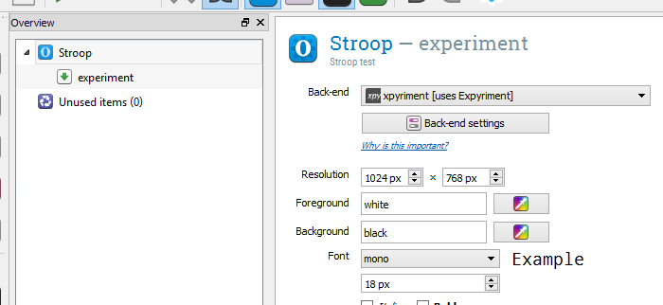
Getting started
Start a new experiment
Delete Getting Started and Welcome from overview on the left
In General Properties, set the resolution to the one of your screen (on student pc’s in trans: 1920x1080)
Give experiment an appropriate name and description
!!!Save regularly (click somewhere before you save)!!!
We talk about this later

Slide 9
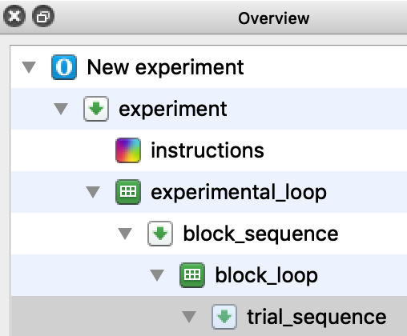
Build basic structure
Add 1 instruction slide (just containing “Press key to start”)
(We’ll skip the Practice Block for today)
Add a new Loop and Sequence item to experiment
Rename the Loop to “experimental loop” and the Sequence to “block_sequence”
Add a new Loop and Sequence item to “block_sequence”
Rename this Loop to “block_loop” and the Sequence to “trial_sequence”

Slide 10
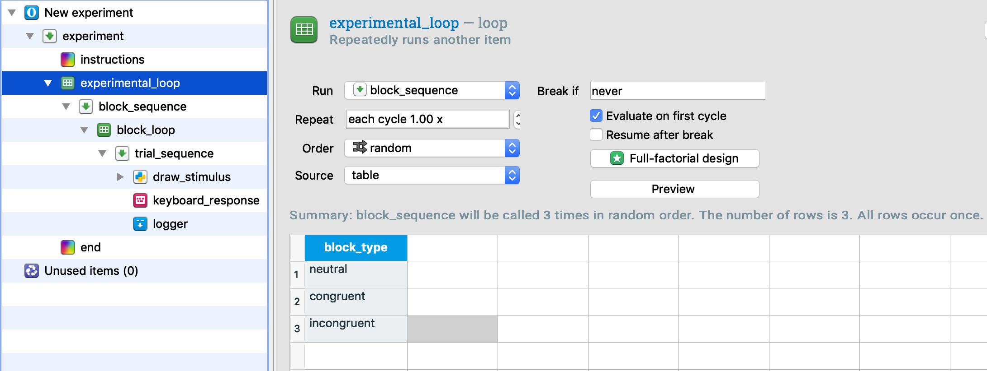
Build basic structure: experimental_loop
Set the column name (your variable) to block_type
Give it the following values: neutral, congruent and incongruent

Slide 11
Build basic structure: variables
What variables are we going to manipulate in our experiment in each trial?
Color of the word
Red, green or blue (word will have one of three colors)
Identity of the word
RED, GREEN, BLUE (congruent/incongruent blocks only)
SPOON, FORK, KNIFE, TABLE, TOWEL (neutral blocks only)
Specific combinations of the words and colors depend on the value of block_type as defined in experimental_loop

Slide 12
Building basic structure
How are we going to implement all these variable combinations that are different for each block_type?
(e.g. The word FORK only occurs in the neutral block, and the word color combination GREEN only occurs in incongruent blocks)
We can do this all using the interface of OpenSesame, but this will be very complex and result in an exremely cluttered overview area (as we need many items to do it like this)
It’s better to use inline_scripts for complex tasks as ours

Slide 13
Build basic structure: inline scripts
inline script = Opensesame item in which you can write your own python code to perform specific tasks
Everything you can do with the interface, you can also do in script
Always specify the independent variables (variables we manipulate) as simple as possible in the experimental_loop and block_loop and retrieve them in inline scripts, in which you take care of the more daunting task of determining what to display on the screen
Add a new inline_script item to trial_sequence and rename it to draw_stimulus

Slide 14
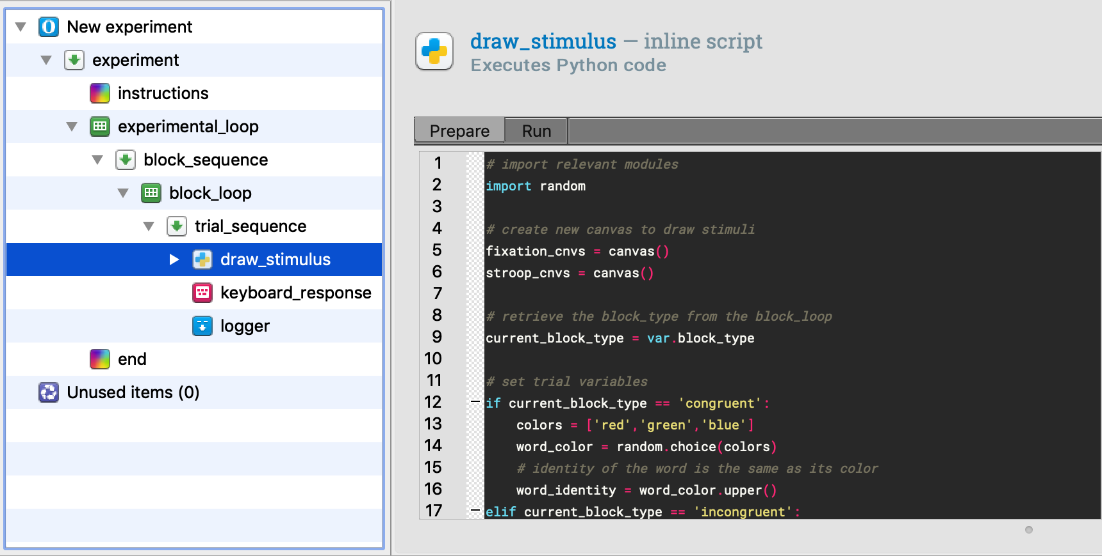
Inline script

Slide 15
Inline scripts: basic usage
Most of the times, an inline script is used to perform the following tasks in a trial:
Get data from loop items
In our case the current value of block_type from experimental_loop
Create stimuli depending on these variables
Prepare drawing of stimuli
Show stimuli
Specify data/information to be logged (optional)

Slide 16
1. Get data from loop items
To get the current value of block_type, you can simply state: >>> current_block_type = var.block_type OpenSesame will find out by itself if it has to get this variable from experimental_loop or block_loop!

Slide 17
2. Create stimuli depending on these data
Now we know the value of block_type, we can determine which word in what color we want to show
I am going to specify 2 variables for this (which we will use later) and determine their value for the current block_type
word_identity: the word that is displayed (e.g. RED, YELLOW, FORK, TABLE, etc.)
word_color: the ink color of the word that is displayed

Slide 18
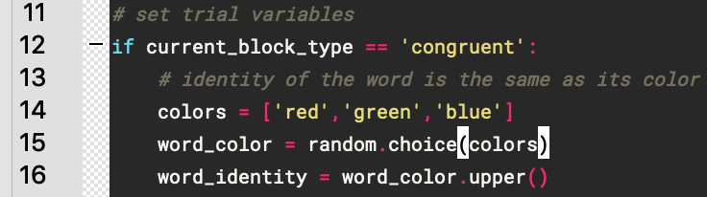
When block_type is congruent
The word has the same identity and color
There are multiple ways to tackle this problem.
One way is to pick a random color from a list of colors with the choice() function from the module random
use import random
After this you can use random.choice()

Slide 19
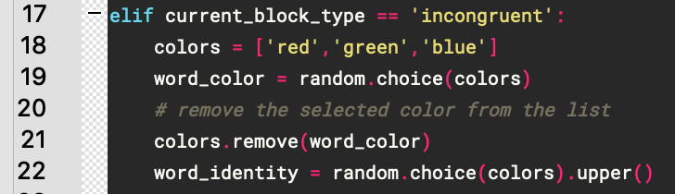
When block_type is incongruent
Word identity and color need to be different (e.g identity: RED and color: red, together are not allowed)

Slide 20
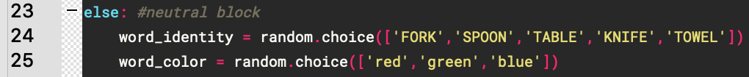
When block_type is neutral
Perform the same steps as incongruent, only now we don’t need to control for illegal combinations as the neutral condition doesn’t have any (every word and color combination are allowed in neutral)

Slide 21
Set correct response
You can set variables that OpenSesame can use in items that follow the inline_script
Syntax: var.<variable_name>=<variable_value> for example: var.chosenWord=word_identity
Remember the variable correct_response that determines what the correct key is that participants need to press?
We are going to set correct_response in our inline_script

Slide 22
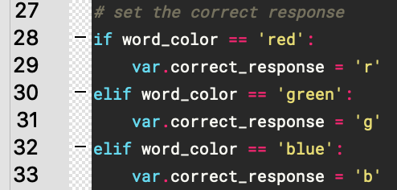
Set correct response
Code for setting correct response (you’ll see how this variable is used further on)
or

Slide 23
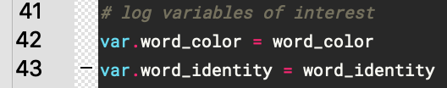
Store important information
Per trial, we want to save what word was shown and in which color

Slide 24
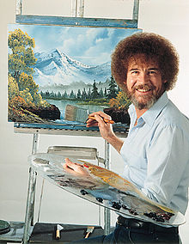
3. Prepare drawing of stimuli
Now we have determined which word we want to show (word_identity) and in which color (word_color), it’s (almost) time to present it to the participant
For drawing, OpenSesame uses the Canvas object

Slide 25
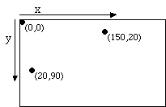
Canvas object
The canvas is an area you can draw to
You specify the place where you want to draw something in x,y coordinates
Top left of screen is (0,0) (NOT bottom left)

Slide 26
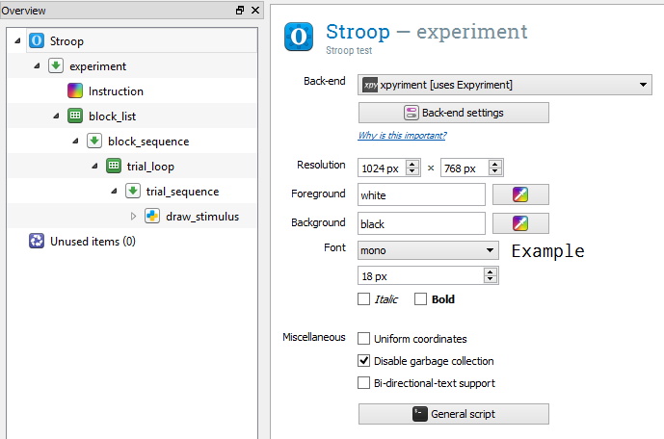
But only…..
If enabled, 0,0 refers to the center of the screen

Slide 27
Canvas object
For a complete description, go to http://osdoc.cogsci.nl/2.9/python/
To create a new, empty canvas you can call the function canvas() from anywhere in the inline script. This function will then return a reference to this canvas, which you can store in a variable
e.g: my_canvas = canvas() #don’t use canvas as variable name!
With this reference you can perform all kinds of drawing operations on the canvas
e.g. draw a circle:
My_canvas.circle(200,300,10) # draw a circle at x=200 and y=300 with radius 10

Slide 28
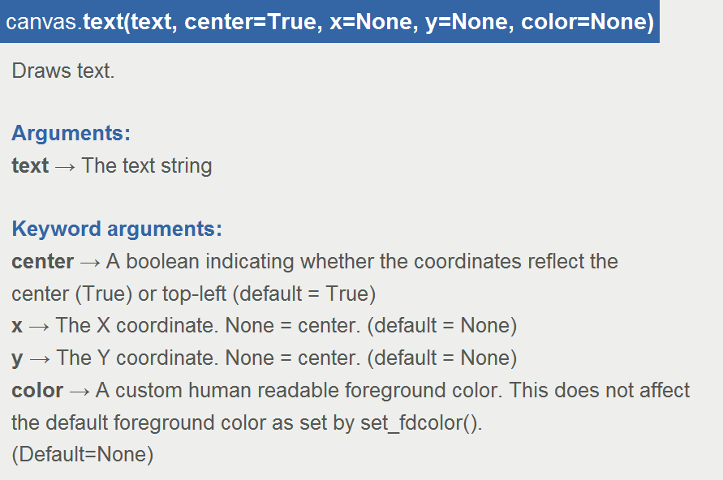
Canvas object
The Canvas object offers a large set of functions you can use to draw stimuli; for instance, to draw text (just what we need!):

Slide 29
Canvas object
To draw the colored word to the screen, we can simply call my_canvas.text(word_identity,color=word_color) and we’re done, right?
Not quite, OpenSesame has drawn everything to a screen buffer or an offline canvas in the background and not to the screen itself yet (so we won’t see anything of our drawing yet)

Slide 30
Screen buffer
Why use screen buffers?
A computer ‘refreshes’ the image on the screen multiple times (60-120x) per second
Some drawing operations are so complex that they can take a long time. If they take longer than a refresh cycle, you can get tearing

Slide 31
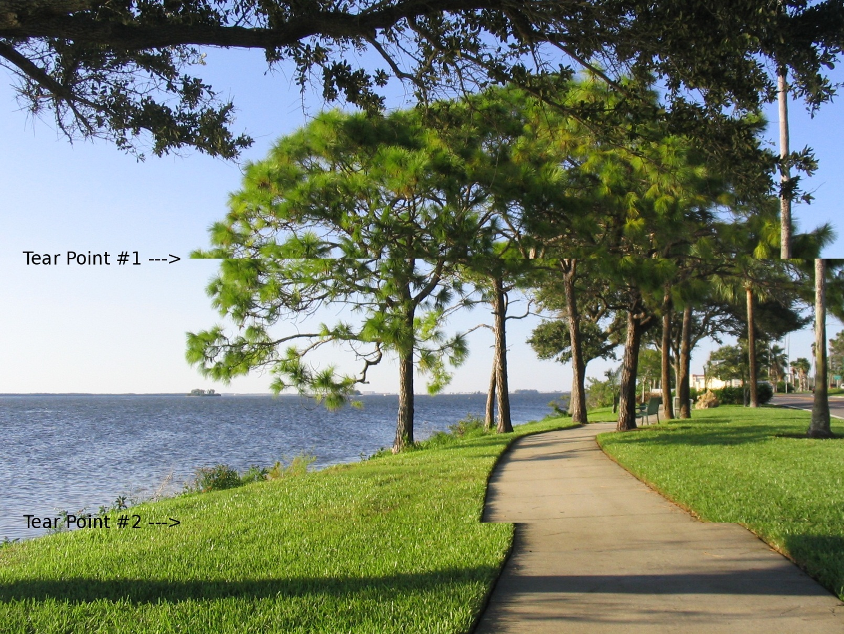
Tearing

Slide 32
Screen buffer
Why use screen buffers?
A computer ‘refreshes’ the image on the screen multiple times (60x-120x) per second
Some drawing operations are so complex that they can take a long time. If they take longer than one refresh cycle, you can get tearing
To prevent tearing, it’s better to draw to a buffer in the background, and copy this buffer to the screen in one go (copying a complete buffer is a really quick operation)

Slide 33
4. Show stimuli
So now we want to show our canvas, which is actually a buffer, to the screen. How do we do that?
By calling the canvas function show(): my_canvas.show()
But we don’t want to do this in this part of the inline script …..

Slide 34

Inline script: prepare and run
Inline script has 2 phases: prepare and run
Before it actually starts a trial, OpenSesame runs all prepare scripts of its inline script items
When it has done this, it executes the run scripts
Prepare | run
Prepare | run
Prepare | run

Slide 35
Inline script: prepare and run
Prepare phase: put all operations that take a long time to complete here
creating canvas and drawing to them,
complex math,
long loops,
etc.
Run phase: quick operations that take a fraction of milliseconds
Copying prepared buffers (canvases) to the screen
Logging data
Especially important if you are measuring RTs!
Operations that take long will add to the RT, making reported RTs longer than they are in reality → keep code in run phase to a minimum when running RT experiments!

Slide 36
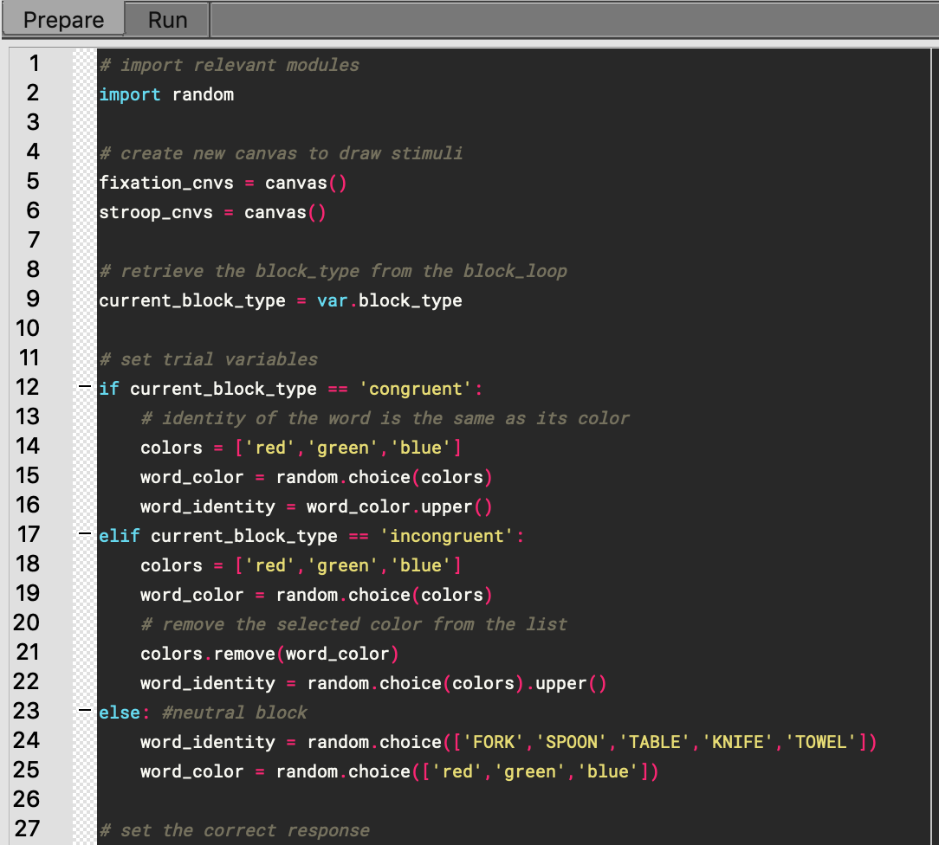
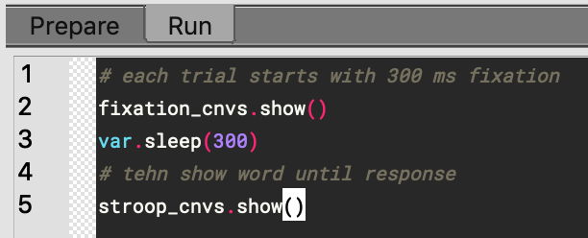
Prepare phase:
Run phase:

Slide 37
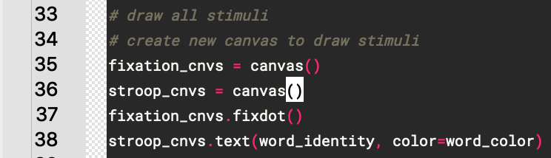
Almost done!
We wanted to display a fixation dot for 300ms before the words are presented
Create a new canvas named fixCanvas and use the fixdot function to create a fixation dot

Slide 38
Show stimuli
Now, in the run phase first show the fixation dot for 300 ms before you show the word
To show something for a certain time, you can use the var.sleep() function

Slide 39
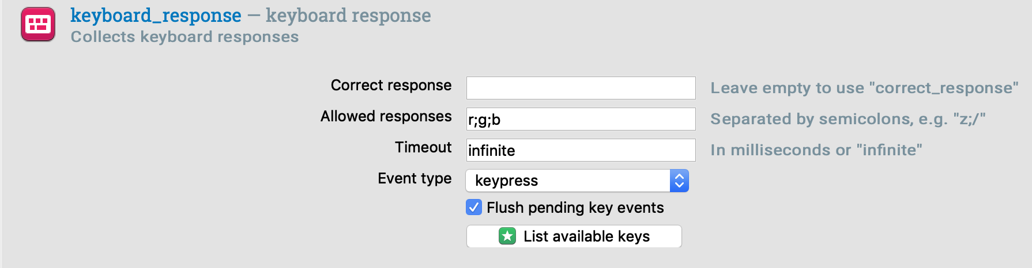
Almost done!
We still need to register responses
Add new keyboard_response item to Trial_sequence
Enter ‘r;g;b’ in the Allowed responses field
Leave correct_response empty (you’ve already set this variable in the script!)

Slide 40
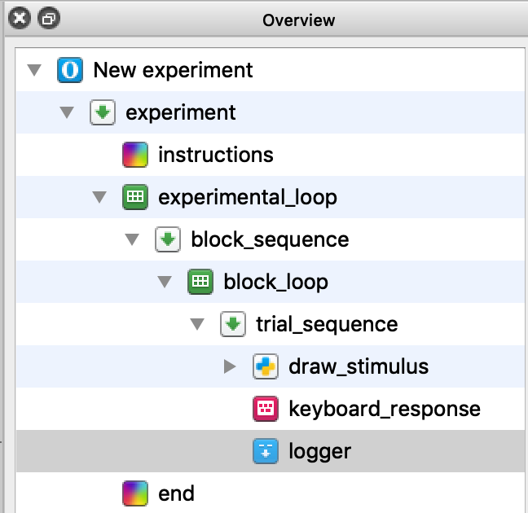
Almost done!
We also want to log these responses, so they are saved in our data file
Add new logger item to Trial_sequence
Keep the default values

Slide 41
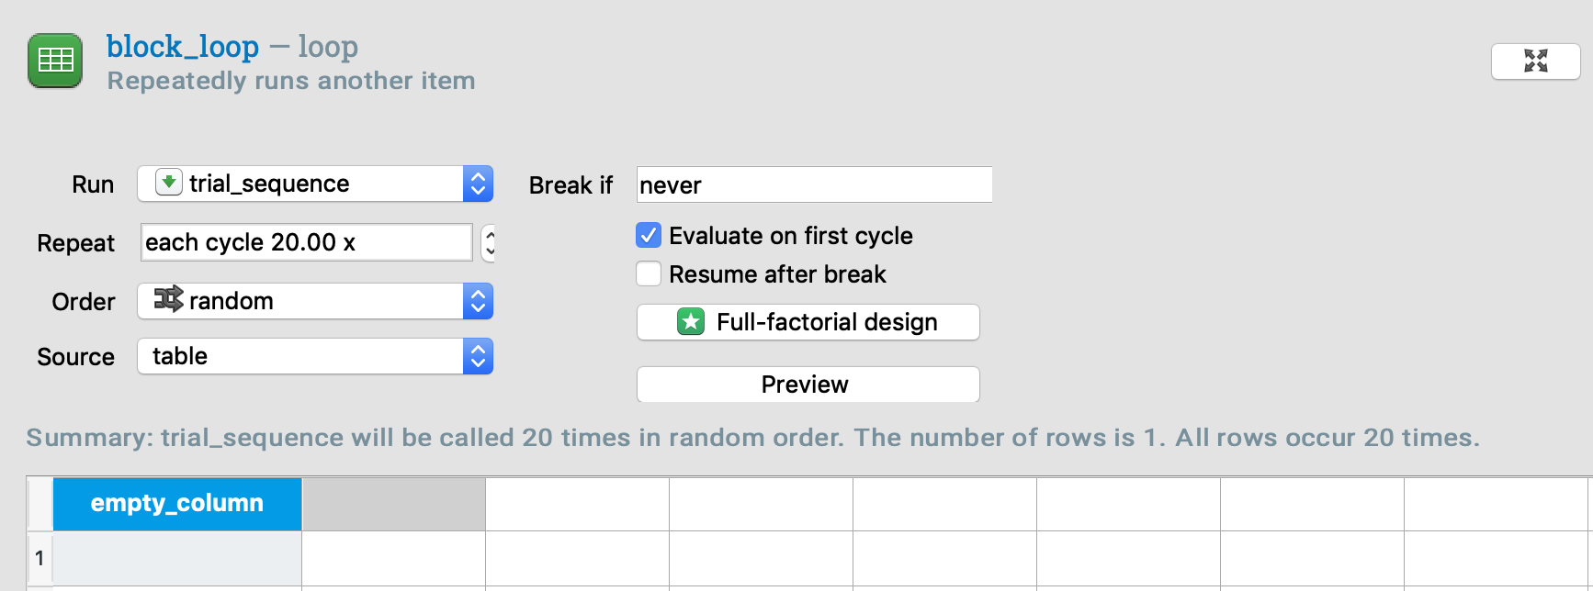
Almost done!
Let’s add some more trials
In the properties of Trial_list set Repeat to 20
The variable list in Trial_list can remain empty, because we created all our variables in our inline_script!

Slide 42
Done!
The experiment will run now!
Don’t forget to add these things in a real experiment!
Instruction slide(s)
Explain task, which buttons to use, etc.
Practice block (+notification when real experiment begins)
Notification slide of block type before each block
“You are now going to do a [block_type] block” → (“You are now going to do a neutral block”)
“Take a break” slide at the end of each block
Goodbye slide

Slide 43
Important lessons of today!
The inline_script has two phases/sections
Prepare: put operations that require some computational power and might take some time here (generating stimuli, drawing, etc)
Run: put operations that can be done quickly here (copying screen buffer, logging data, etc.)
The var object contains useful functions to communicate with other items outside the inline_script and easily log variables.
The Canvas object is used to draw stimuli to and afterwards display them on the screen
Draw stimuli to canvas in prepare phase, show the canvas to the screen in the run phase, to prevent tearing

Slide 44
Just handy…
If OpenSesame doesn’t respond anymore, then press the escape button to quit the experiment!

